Slide 1
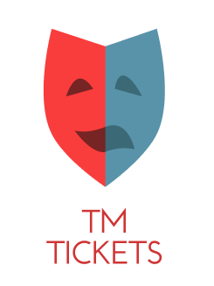
TM TICKETS Theatre
Team 5:
Alessandra 21565
Taiane 21913
Yuri 21789

Slide 2
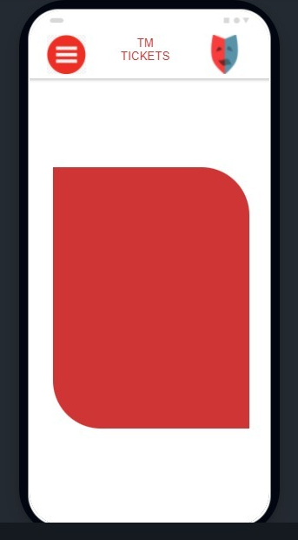
Splash screen

Slide 3
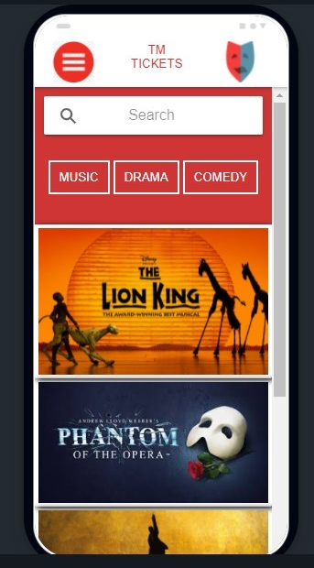
Main Screen
Search Bar
Concerts

Slide 4
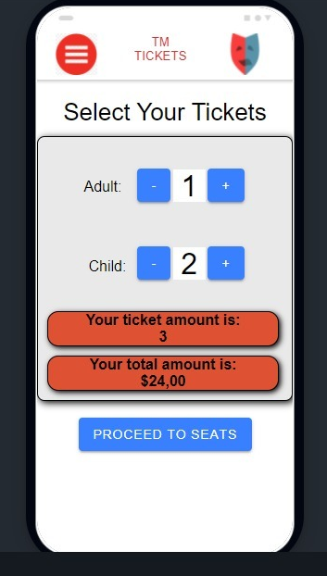
Ticket Screen
Select the ticket

Slide 5
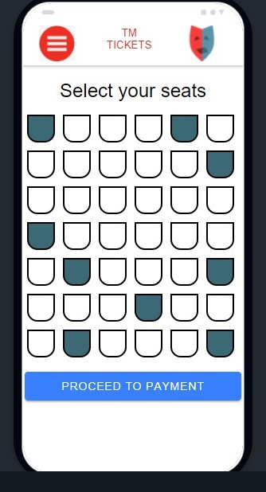
Select seats screen

Slide 6
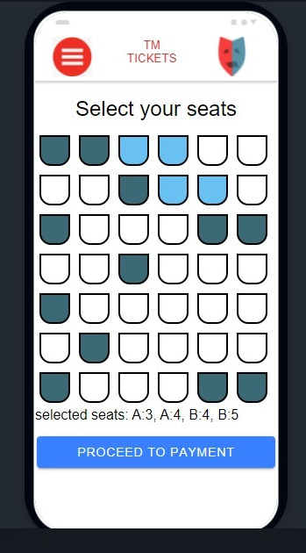
X
X
Selected seats
X
X

Slide 7
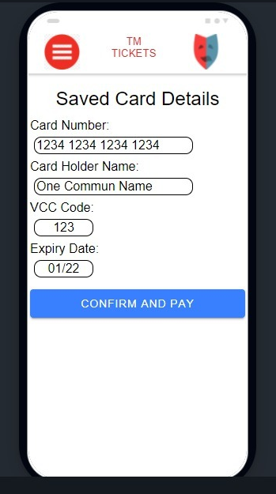
Payment Screen

Slide 8
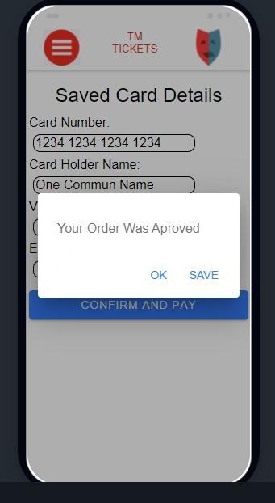
Approved Payment

Slide 9
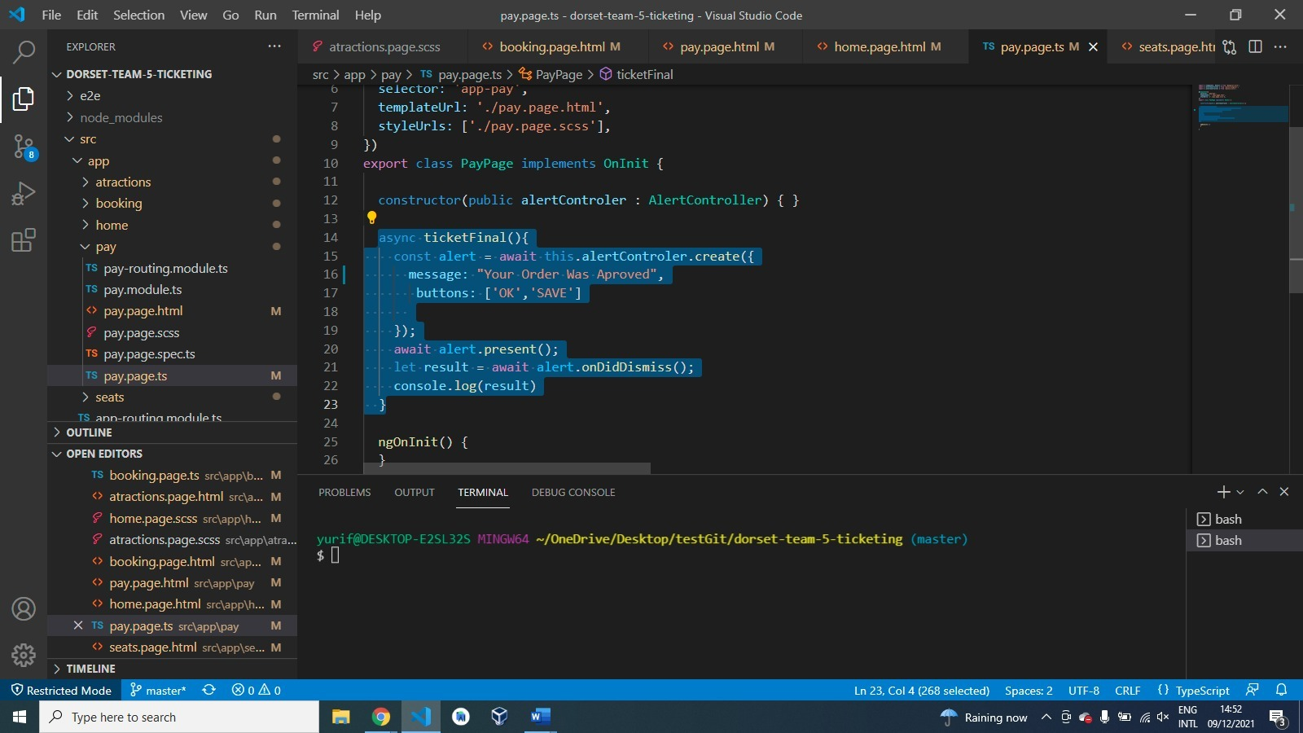

Slide 10
FIGMA PROTOTYPE https://www.figma.com/proto/LY740XU0mnWxdo975wWXXA/PROTOTYPE-GROUP-5---MOBILE-PROJECT---FINAL-CA?node-id=112%3A2&scaling=scale-down&page-id=0%3A1&starting-point-node-id=112%3A2 FIGMA WIREFRAME https://www.figma.com/file/tPI374mqfBmDAgHtW1ucFn/WIREFRAME-GROUP-5---MOBILE-PROJECT---FINAL-CA

